Slide 1
VIP 2.0
Team Members:
Tiago Moore, Victoriano Vega, Steven Rowe,
Jorge Perez, Andres Villa, Miguel Conde, Rodolfo Viant Product Owner:
Masoud Sadjadi Instructor:
Masoud Sadjadi
School of Computing and Information Sciences Florida International University
Senior Project Final Presentation Spring 2016
3/7/2016
Notes:
Greet your audience, thank them for attending your presentation, introduce yourself, introduce your project, introduce your team members, and quickly indicate what each of you did in a high-level manner, and put more emphasis on your part/contribution.

Slide 2
Problem Definition
Our Project
Mobile Judge is a web application that is built more for mobile devices to be the primary use. Mobile Judge is the application that judges will be using to score students during the senior project showcase.
Current Problems
Lacked the ability to accept/reject grades
View/update user profile page
Ability for admin to filter email selections
Social media account linking
Pagination on all grids
Export grades/judges
Import Students
Manage Student/Judges information
My Part
Global Pagination of Grids
Add Server Monitoring (Tech Depth)
Notes:
Introduce the problem that the whole project tackles and stay focused on the parts that you have been working. Indicate if there is an existing previous system, enumerate its problems/limitations, etc.

Slide 3
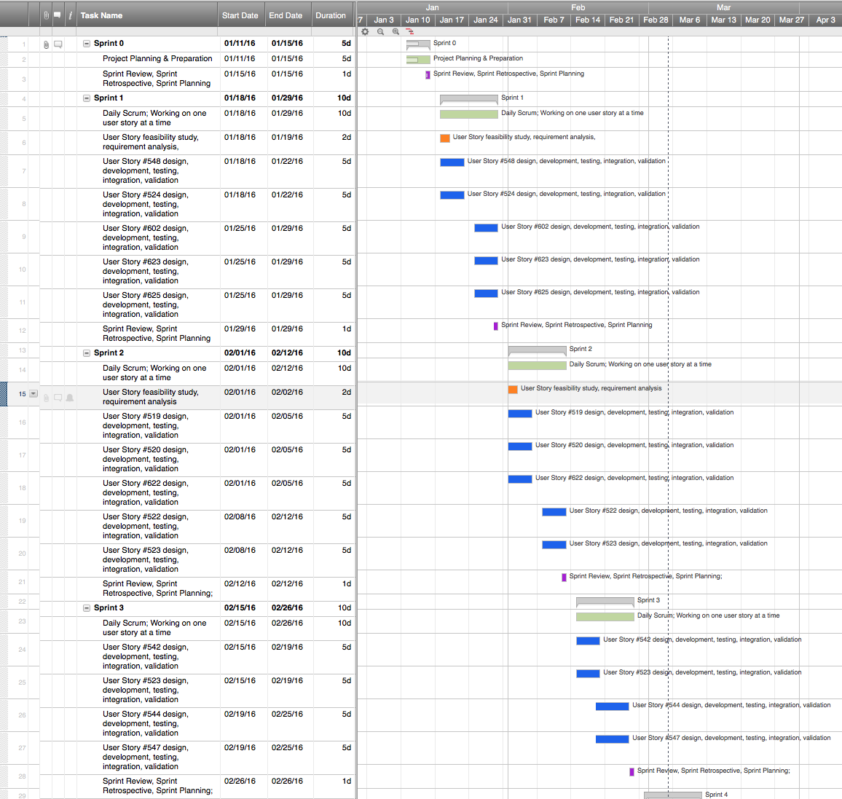
Project Management
Notes:
Project Management (schedule for entire semester) (one slide; Gantt Chart).

Slide 4
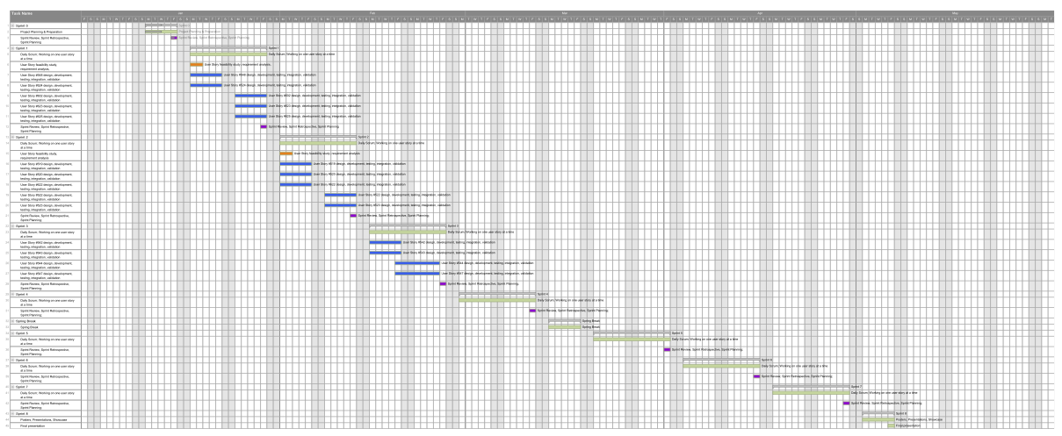
Full Gantt chart

Slide 5
Requirements: User Stories
#524 - Manage List Size
#619 - Setup Server Monitoring (Tech Depth)
Notes:
4. Requirements:
4.1. User stories implemented (one or more slides).
4.2. UML use cases and the use case diagram for the implemented use cases (one or more slides).
4.3. UML sequence diagrams for the implemented use cases.

Slide 6
Requirements: Use Cases
Notes:
4. Requirements:
4.1. User stories implemented (one or more slides).
4.2. UML use cases and the use case diagram for the implemented use cases (one or more slides).
4.3. UML sequence diagrams for the implemented use cases.

Slide 7
Requirements: Use Cases
#524 - Manage List Sizes
Details:
Actor: Admin
Pre-conditions:
Admin has successfully logged onto the system.
Admin is on the Email or People tab.
Description:
The use case begins when the admin clicks the list size combo box on the Email or People view.
The admin then clicks on one of the list size options.
The size of the list then updates to only show the size that the admin selected.
Post-conditions:
The list is now the size that the admin selected.
Exceptions:
Error updating the list size.
Notes:
4. Requirements:
4.1. User stories implemented (one or more slides).
4.2. UML use cases and the use case diagram for the implemented use cases (one or more slides).
4.3. UML sequence diagrams for the implemented use cases.

Slide 8
Requirements: Sequence Diagrams
#524
Notes:
4. Requirements:
4.1. User stories implemented (one or more slides).
4.2. UML use cases and the use case diagram for the implemented use cases (one or more slides).
4.3. UML sequence diagrams for the implemented use cases.

Slide 9
System Design: Architecture
3-tier architecture and Client-Server
Security/Privacy
Oauthd authentication
Hashing and salting of passwords
Sanitizing user input
Token based authentication (bcrypt)
Notes:
5. System design:
5.1. System decomposition; identify the architecture patterns used (one slide).
5.2. System deployment – h/w and s/w requirements (one slide).
5.3. Persistent data design (one slide).
5.4. Security/Privacy (one slide).

Slide 10
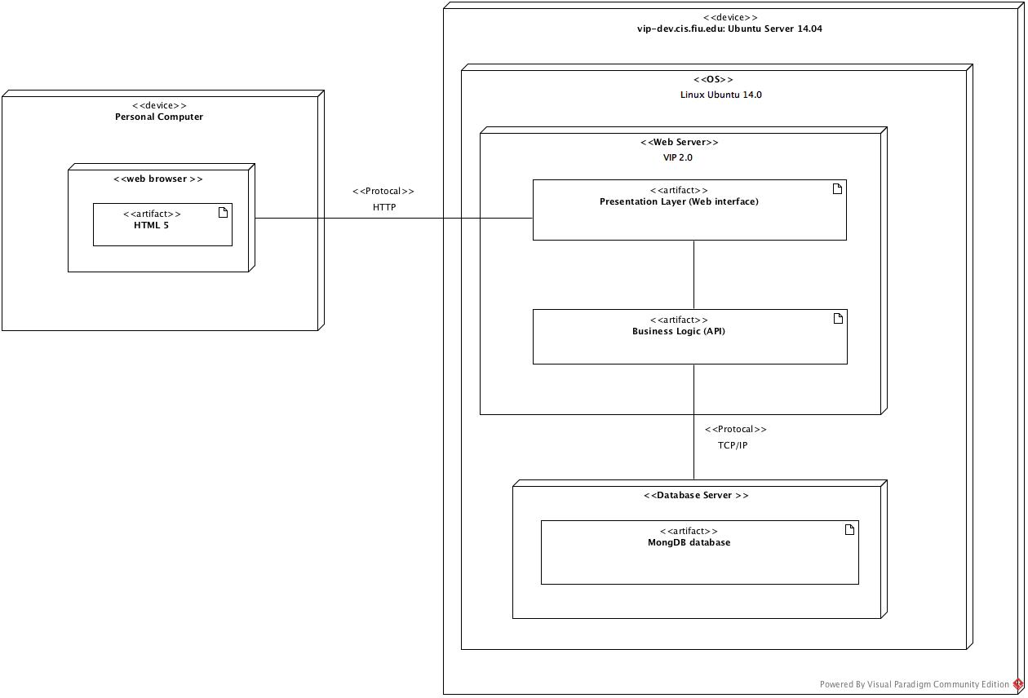
System Design: Deployment
Notes:
5. System design:
5.1. System decomposition; identify the architecture patterns used (one slide).
5.2. System deployment – h/w and s/w requirements (one slide).
5.3. Persistent data design (one slide).
5.4. Security/Privacy (one slide).

Slide 11
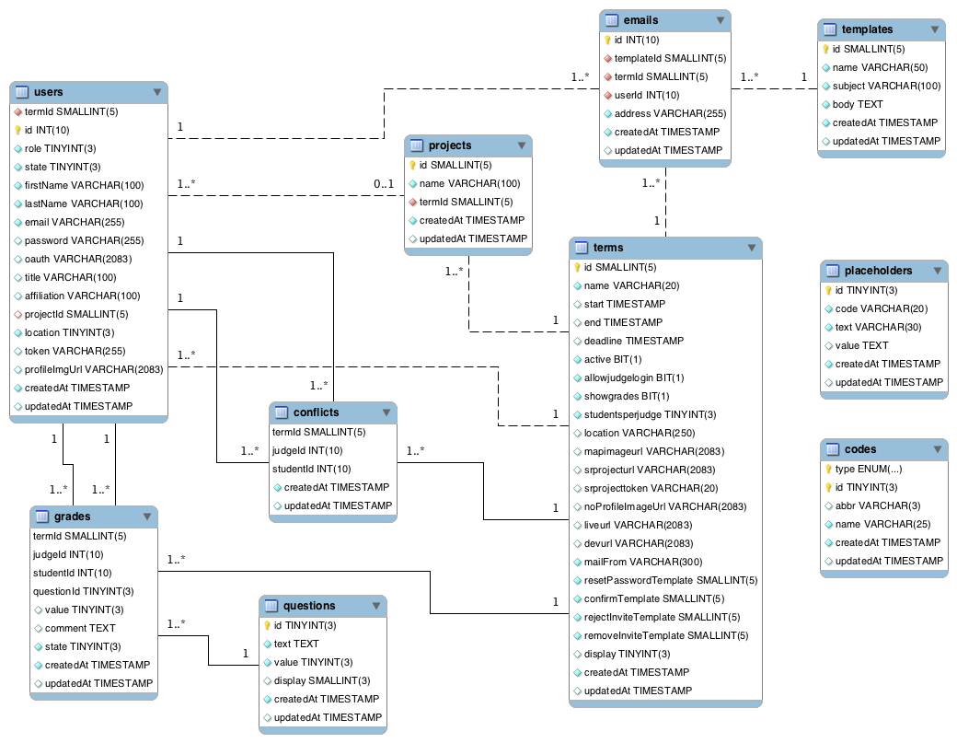
System Design: Persistent data design
Notes:
5. System design:
5.1. System decomposition; identify the architecture patterns used (one slide).
5.2. System deployment – h/w and s/w requirements (one slide).
5.3. Persistent data design (one slide).
5.4. Security/Privacy (one slide).

Slide 12
Minimal Class Diagram
Notes:
6. Detailed design:
6.1. Minimal class diagram. Identify the design patterns used (one or more slides).
6.2. State machine for the main control object or the most important object of the implemented uses cases (one or more slides).
6.3. Main algorithm used related to an implemented use case described above (one or more slides).

Slide 13
Test Cases -#524 Manage List Size
Sunny Day
Purpose
Test if the ‘10’ list size button changes the list to 10 items when the default size list size is shown.
Precondition
User is logged into the system
User is in the People page
User is in the Students Tab
List size is currently 25 (default)
Input
User clicks option ‘10’ in the List Size Combo Box
Expected Result
List size of the Students grid changes from 25 to 10.
Actual Result
List size of the Students grid changes from 25 to 10.
Notes:
7. Test Suites and Test Cases (one sunny day and one rainy day) for the use case represented in part (5) above (2 slides).
7.1 One sunny day and one rainy day for the implemented use cases (one or more slides).
7.2 Automated test scripts for the implemented use cases (one or more slides).

Slide 14
Test Cases -#524 Manage List Size
Rainy Day
Purpose
Ensure that the list size does not change when internet connection is lost
Precondition
User has successfully logged into system
User is on the People page
User disconnects from internet
List size is 25 (default)
Input
User clicks option ‘10’ in the List Size Combo Box
Expected Result
Error message pops up with message “You have lost internet connection. Please reconnect.”
Actual Result
Error message pops up with message “You have lost internet connection. Please reconnect.”
Notes:
7. Test Suites and Test Cases (one sunny day and one rainy day) for the use case represented in part (5) above (2 slides).
7.1 One sunny day and one rainy day for the implemented use cases (one or more slides).
7.2 Automated test scripts for the implemented use cases (one or more slides).

Slide 15
Questions?
Contact information:
Jorge Perez email: jpere268@fiu.edu
Notes:
Summarize your contribution
Include your contact information
Ask if anyone has any questions for you.
Thank your audience

